Slide 3
Building Bulletproof Integrations - Data Entities, OData, and Custom Services

Slide 4



Peter Ramer
Director of Managed Application Services
RSM
Email: peter.ramer@rsmus.com
Blog: http://dynamics365musings.com/
LinkedIn | Microsoft MVP Profile
Background:
Awarded Microsoft MVP in Business Applications since 2022
Been working with AX since 2006 and D365FO since 2016
Have written code that was then purchased and included into the standard F&O product.
Have a blog and YouTube channel that contains lots of technical tutorials.

Slide 5

Nathan Clouse
Sr. Technical Architect
HSO
Email: nathan.clouse@armanino.com
Blog #1: https://www.atomicax.com
Blog #2: https://www.dynamics.fo
GitHub: https://github.com/NathanClouseAX
@NathanClouseAX on most platforms
Background:
Awarded Microsoft MVP in Business Applications since 2019
Been working with AX since 2009
Been working with D365FO since 2017
Have spoken at Summit, Focus, and local chapters around various AX/D365FO technical topics plus other groups events

Slide 6
Section 1: Resilient Integration Architectures
Choose the right channel. Build for failure. Plan for scale.

Slide 7
Why Integrations Fail in Production
Wrong channel for the workload — OData under bulk load, DMF for sub-second calls
Throttled by the platform with no Retry-After handling
Lock contention on hot tables (NumberSequenceTable, ledger journals)
Duplicate posts after a transient timeout — no idempotency key
Schema drift: caller assumes fields that the next entity version drops
The cost shows up downstream: missing invoices, duplicate orders, broken reports.

Slide 8
Three Integration Channels in F&SCM
Data Management Framework
  Recurring Integrations API
  Asynchronous, batch-oriented, file-based
  Handles thousands of rows safely
Decision rule of thumb
  OData: <= a few hundred rows per call
  DMF: scheduled or thousands of rows
  Custom service: when no entity fits, and you need to run business logic and return a result
OData (REST/JSON, V4)
  /data/{EntitySet} on the AOS endpoint
  CRUD over public data entities
  Best for interactive, low-volume calls
Custom Services
  /api/services/{Group}/{Service}/{Op}
  X++ classes exposed as REST
  Best for business actions, not data shapes

Slide 9
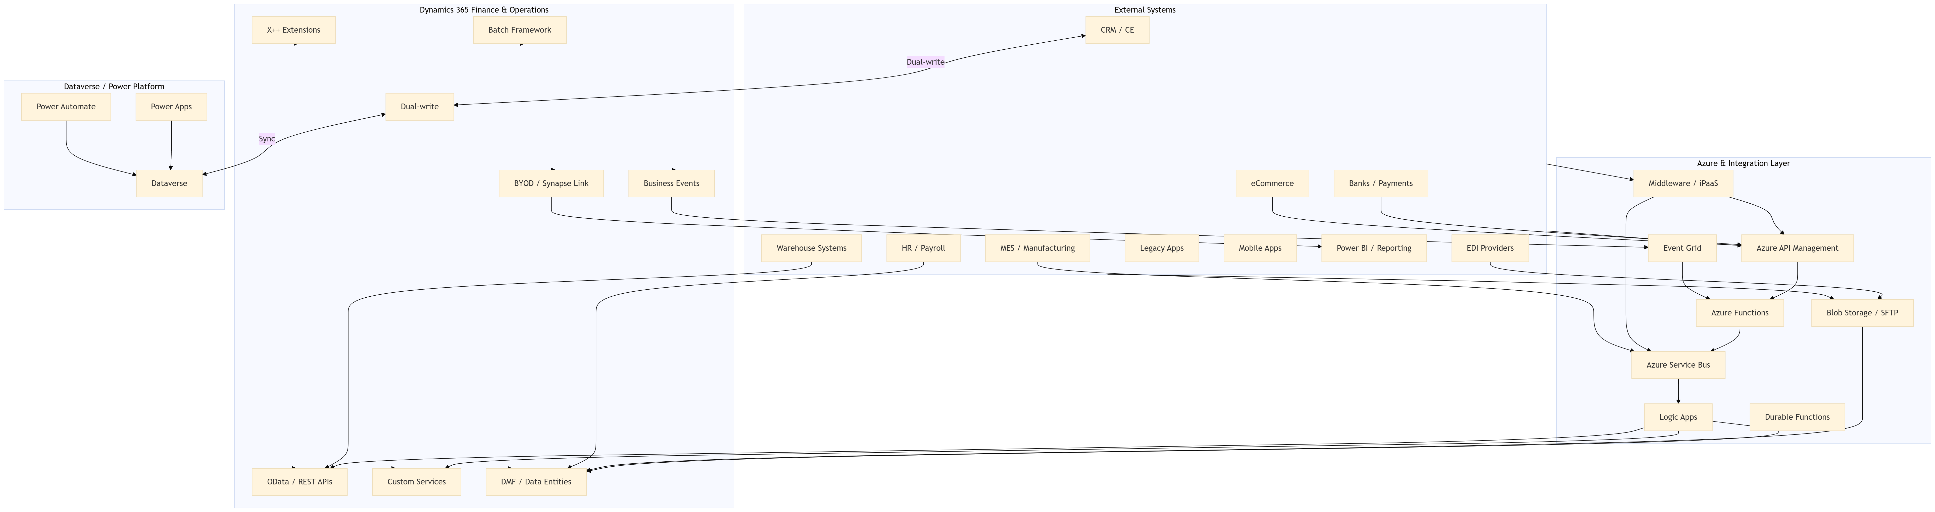

Slide 11
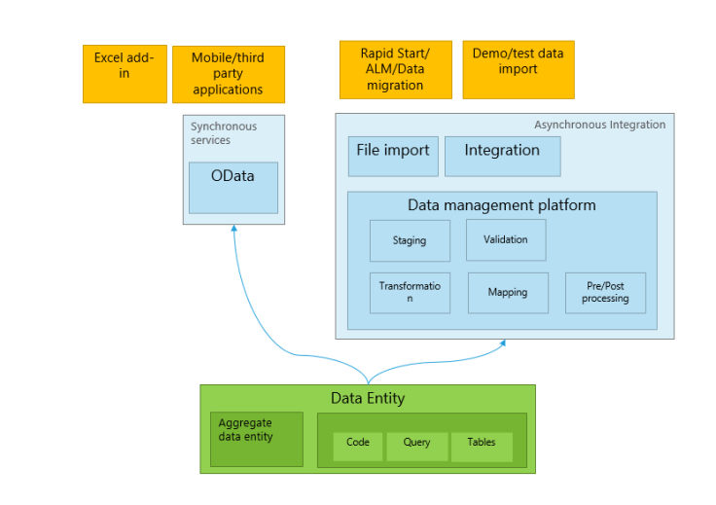
Data Entities
What is a Data Entity?
How To Create A D365 Data Entity
How To Use A D365 Data Entity
Export Data To Excel In D365
Update Data From Excel in D365

Slide 12
OData: REST/JSON for Interactive Workloads
Endpoint: GET https://{env}.dynamics.com/data/CustomersV3
Query operators: $filter, $expand, $select, $top, $skip, $count, $batch
Cross-company queries require ?cross-company=true plus an explicit dataAreaId filter
Only entities with IsPublic = Yes are exposed
OData actions decorate methods with [SysODataActionAttribute] for hybrid logic on entities
Pin to versioned entity names (CustomersV3, not whatever ships next).

Slide 13
Custom Services: Resources
Create A Custom Service in D365
Create A Complex Service in D365
Set up Postman To Call D365

Slide 14
Custom Services: Business Operations as APIs
Use when the operation is a verb, not a noun: post invoice, release order, confirm shipment
X++ class registered to a service group (extend SysOperationServiceBase for async/batch support)
Endpoint pattern: /api/services/{ServiceGroup}/{Service}/{Operation}
Returns JSON over REST; SOAP endpoints exist but are deprecated for new work
Run heavy work asynchronously via the Batch OData API (SysOperationServiceController)
Always wrap server logic in try/catch and surface a structured error contract

Slide 15
Data Management Framework: The Bulk Path
Recurring Integrations API for asynchronous, file-based, high-volume scenarios
POST /api/connector/enqueue/{activityId}?entity={name} pushes a payload (JSON/XML/CSV/package)
GET /api/connector/dequeue/{activityId} + /ack/{messageId} pulls and confirms exports
Poll job state with GetMessageStatus — terminal states: Processed, PreProcessingError, PostProcessingError
Composite entities (parent + child like SalesOrderHeader + lines) ship as a single message
Data Project staging tables let you inspect failures before they hit production tables

Slide 16
Choosing the Right Channel
Pick DMF when
  Volume is in the thousands
  Source is a flat file or feed
  Schedule-driven, not event-driven
  Errors must be inspected per row
Hybrid options
  Virtual entities for Power Platform
  Dual-write for Dataverse-bound apps
  Composite entities for parent+child
Pick OData when
  Sub-second response is required
  Volume is small to moderate
  CRUD on a single entity
  UI or low-latency app is calling
Pick a Custom Service when
  The work is a business action
  Logic spans multiple entities
  Caller needs a contract, not a table

Slide 17
Authentication with Microsoft Entra ID
All server-to-server integrations use OAuth 2.0 client-credentials against Entra ID
  POST https://login.microsoftonline.com/{tenant}/oauth2/v2.0/token
  grant_type=client_credentials & scope={env}/.default
Three setup steps in F&SCM
  1. Register app in Entra ID — capture tenant, client ID, certificate (preferred over secret)
  2. Register the app inside F&SCM — System administration > Setup > Microsoft Entra ID applications
  3. Bind the client ID to a service-account user with least-privilege roles
One app registration per logical integration — never share a single service account

Slide 18
Idempotency: Safe to Retry
Why it matters
  Networks fail mid-flight
  Timeouts hide successful posts
  Blind retries create duplicates
OData PATCH on a natural key is naturally idempotent.
Patterns that work
  Send a client-generated correlation ID
  Persist the messageId from DMF enqueue before ack
  Build a de-dupe table keyed on correlation ID
  Return the original result on duplicate detection — never reprocess
  Treat 409/412 conflicts as success on retry

Slide 19
Section 2: Error Handling & Recovery
Plan for the failure modes you will hit on day one in production.

Slide 20
Transient vs. Permanent Failures
Transient — retry with backoff
HTTP 408 Request Timeout, 429 Too Many Requests
HTTP 502 / 503 / 504 from gateway or AOS
Network timeouts and TLS handshake errors
Permanent — route to dead-letter, alert, do not retry
HTTP 400 / 401 / 403 / 404
422 validation failures (bad data shape)
DMF PreProcessingError on malformed payload
Treat anything else as transient until proven otherwise.

Slide 21
HTTP 429: Honor Retry-After
Reference handler (C#)
if ((int)response.StatusCode == 429) {
int s = 30;
if (response.Headers.Contains("Retry-After"))
s = int.Parse(response.Headers
.GetValues("Retry-After").First());
Thread.Sleep(TimeSpan.FromSeconds(s));
// retry the request
}
The contract
  F&SCM returns 429 with a Retry-After header in seconds
  Aggressive retries during throttling worsen the problem
  Repeat offenders get de-prioritized further
Sleep first, then retry — exactly what the platform asked for.

Slide 22
Exponential Backoff with Jitter
Layer backoff on top of Retry-After for transient 5xx and network errors
delay = min(cap, base * 2^attempt) + random(0, jitter)
Recommended starting values: base = 1s, cap = 60s, jitter = 1s, max attempts = 5
Add jitter to prevent thundering-herd retries from synchronized clients
Reset the attempt counter on every successful response
Trip a circuit breaker after N consecutive failures — fail fast, page the on-call
Log every retry with: correlation ID, attempt #, Retry-After value, final status

Slide 23
Validate Before You Send
Validate at the integration boundary — fail in your code, not on the AOS
Required fields, formats, lookup values, enum values, foreign keys
Run a schema diff against the entity metadata document at deploy time
Use $select to pin the exact field list — additive changes never break you
On the F&SCM side, validate inside doInsert / validateWrite, not in posting code
Build a sandbox replay harness — last week's payloads, this week's code
Bad data caught early is cheap. Bad data caught at month-end is a war room.

Slide 24
Workbench Form and Staging Table
One option is to insert the data into a staging table, and have a batch job process it after it makes it into D365.
Add logging tables that relates to the staged data and make it visible in the form.
Add a button for retrying a record or records after you fix the issue.
Add statuses of say 'to be processed', 'error', and complete.
Put the end user in control to solve more problems

Slide 25
Section 3: Performance Optimization
Batch, set-based, parallel — and prove it with telemetry.

Slide 26
OData $batch: Bundle Your Requests
Endpoint: POST /data/$batch — bundle up to 1,000 sub-requests in one round-trip
Optional change sets group writes into atomic units within the batch
Default page size is 1,000; max 10,000 rows per page with Prefer: odata.maxpagesize=10000
Each change set is atomic; the batch as a whole is NOT — group related writes together
Use Prefer: return=minimal on bulk inserts to skip echoing the resource payload
One $batch call beats one thousand round-trips — every time.

Slide 27
Set-Based vs. Row-by-Row in X++
Silent fallback to row-by-row when
  Database log is enabled on the table
  Alerts are configured on the table
  Row-level security is active
  Override of insert / update / delete exists
  DeleteAction cascades are defined
The right way
insert_recordset dest (FieldA, FieldB)
select FieldA, FieldB from src
where src.Status == Status::Open;
update_recordset cust
setting CreditLimit = 50000
where cust.Group == 'GOLD';

Slide 28
Parallel Processing Patterns
Partition by a stable key — company, date range, customer group — never random
Use the SysOperation framework for batch bundles with controlled parallelism
Schedule async work via the Batch OData API (SysOperationServiceController)
Cap concurrency below the throttling ceiling: 52 concurrent requests per user/app/web-server
Stagger start times to avoid lock contention on shared tables
Parallelism without observability is gambling — instrument every worker

Slide 29
Change Tracking & Delta Queries
Pull only the rows that changed since your last sync — not the whole table
Client sends Prefer: odata.track-changes; F&SCM returns a delta link
Two modes available
Classic — None / Primary table / Entire entity / Custom query (uses SQL change tracking)
Row-version (10.0.34+) — uses rowversion columns; faster, no SQL CT enable required
Persist the delta link with your job state — losing it means a full reload
Test the truncation behavior: SQL change tracking expires retention windows aggressively

Slide 30
Priority-Based Throttling
Configure priorities
  System administration > Setup > Throttling priority mapping
  Distinct service principals per integration
  Tag business-critical flows as High
  Low-priority integrations throttle first
Without explicit mapping, every integration competes equally.
Per-user / per-app limits (10.0.33+)
Exempt today (may change)
  6,000 requests per 300 seconds
  1,200 seconds combined execution per 300 seconds
  52 concurrent requests per user / app / web-server
  DMF, Recurring Integrations, dual-write, virtual tables
  Microsoft has stated this is temporary

Slide 31
Telemetry with Application Insights
Wire the connection string in System parameters — instrumentation key on older builds
LCS Environment Monitoring shows 'Requests throttled', long-running SQL, AOS event logs
KQL example — top entities by p95 latency over the last hour:
requests | where timestamp > ago(1h)
| where url contains "/data/"
| summarize p95=percentile(duration,95), n=count(),
errors=countif(success==false) by name
| order by n desc
Instrument your client too: correlation ID, entity, batch size, retry count, Retry-After value

Slide 32
Lessons Learned: Common Pitfalls
One service account for everything
  Loses priority granularity and forensic clarity
Lock contention on hot tables
  NumberSequenceTable, ledger journals
  Stagger batches; pre-allocate number sequences
Schema drift breaks consumers
  Always pin $select and entity version
Ignoring Retry-After
  Aggressive retries make throttling worse
Assuming exempt services stay exempt
  Microsoft has signaled change

Slide 33
Key Takeaways
Match the channel to the workload — OData, custom service, or DMF
Make every operation idempotent — correlation IDs, natural keys, de-dupe tables
Honor Retry-After before adding your own backoff — and always add jitter
Set-based X++ wins by orders of magnitude — but audit for silent fallback triggers
Configure throttling priorities and isolate integrations with their own service principals
Instrument both sides of the wire — Application Insights + LCS + your own client logs
If you cannot see it, you cannot fix it. Telemetry is not optional.

Slide 34
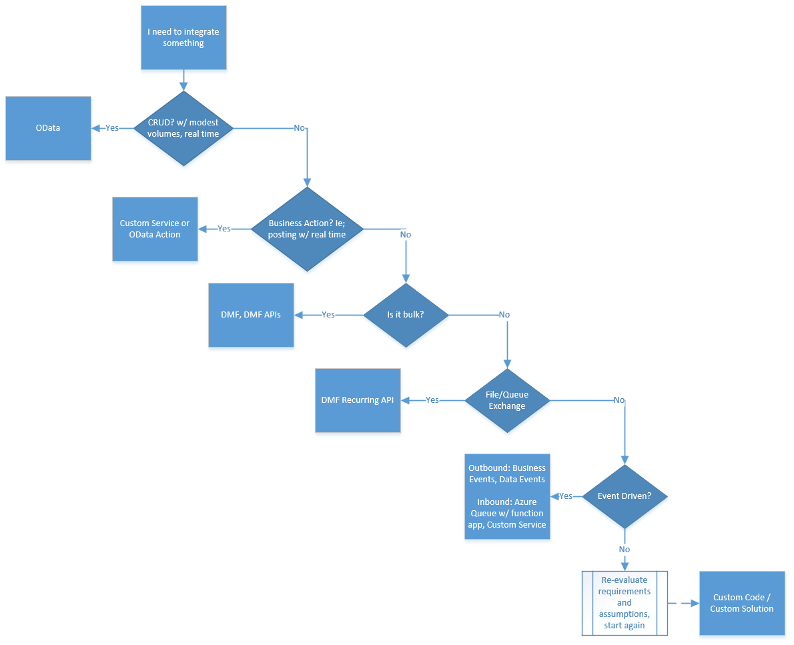

Slide 42
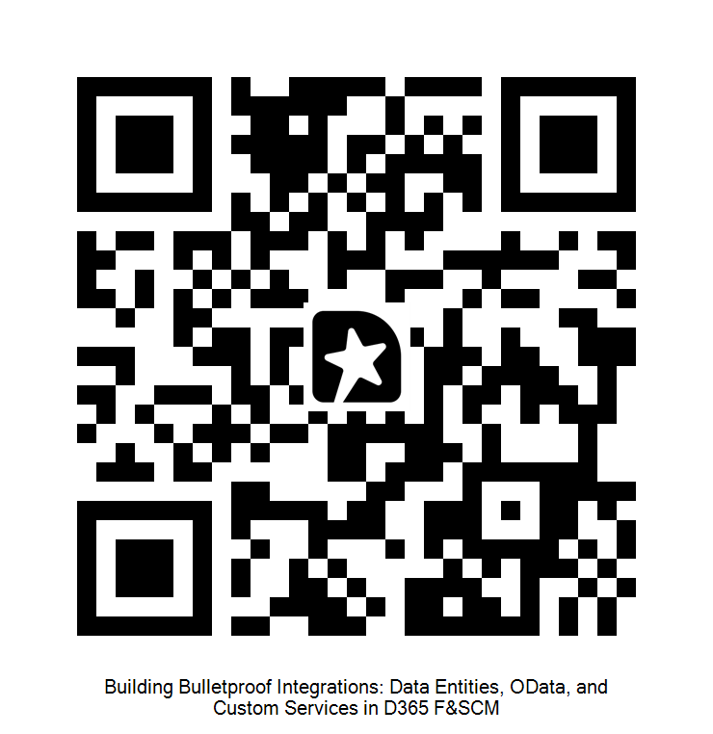
Questions & Discussion

Slide 43

Nathan Clouse
Technical Architect
HSO
Email: nathan.clouse@armanino.com
Blog #1: https://www.atomicax.com
Blog #2: https://www.dynamics.fo
GitHub: https://github.com/NathanClouseAX
@NathanClouseAX on most platforms

Slide 44

Questions?
Peter Ramer
Director of Managed Application Services
Email: peter.ramer@rsmus.com
Blog: http://dynamics365musings.com/
LinkedIn | Microsoft MVP Profile

Slide 45
Questions & Discussion

